Slide 1
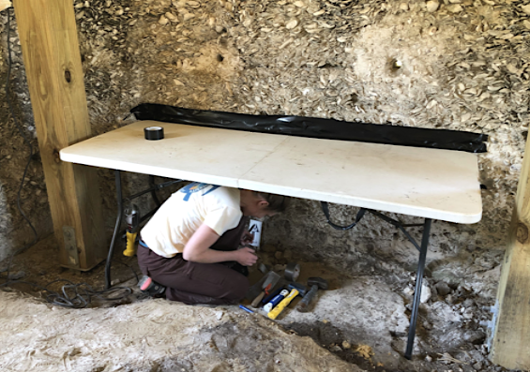
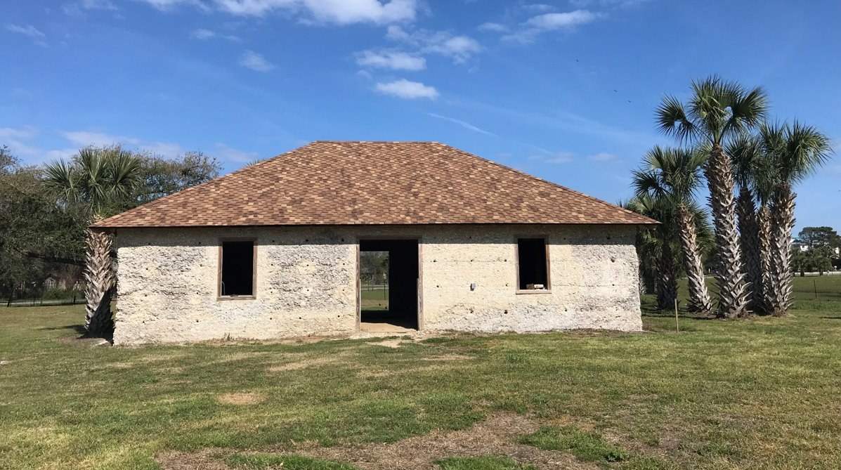
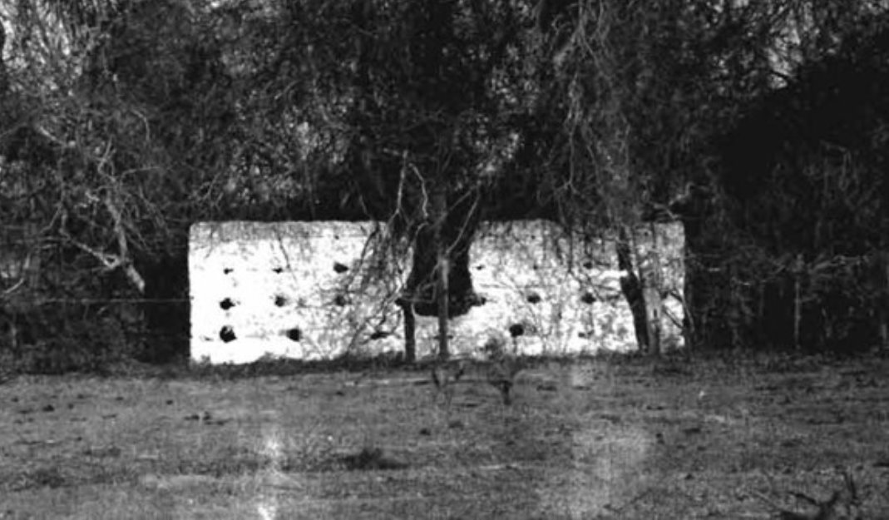
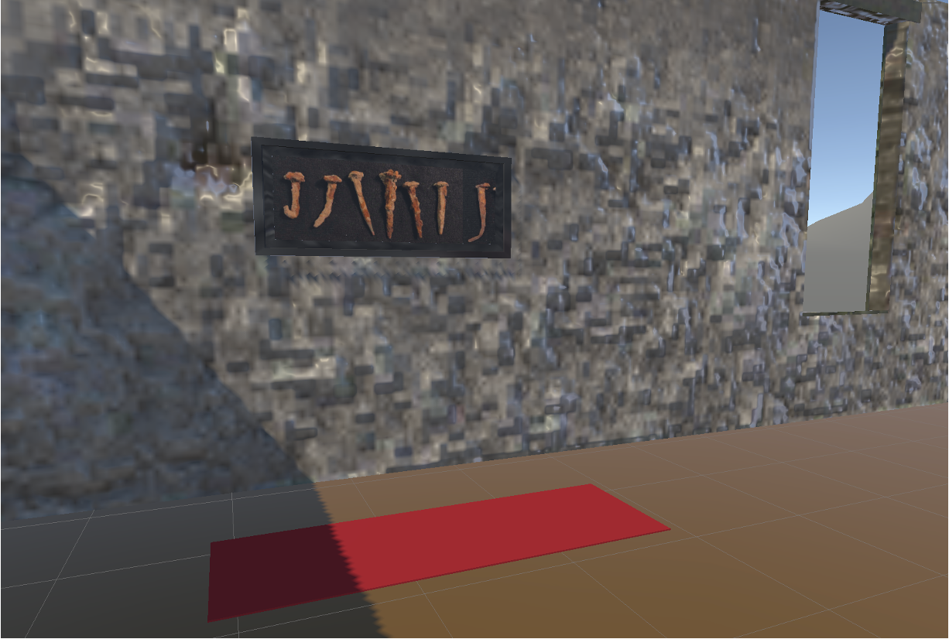
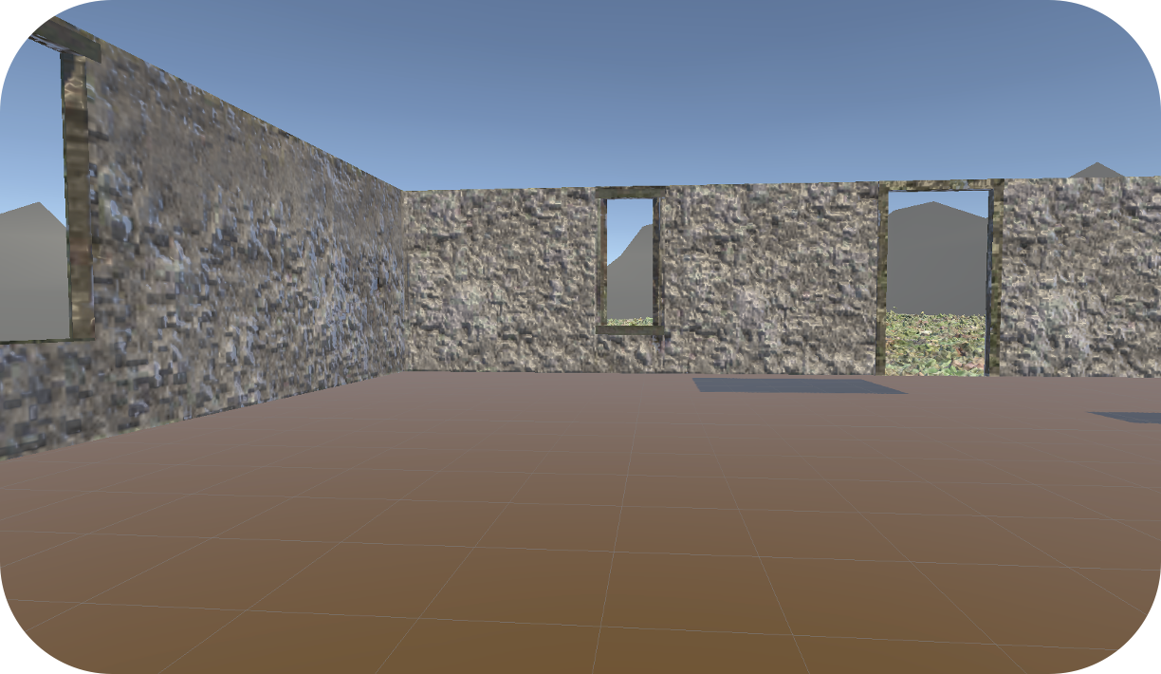
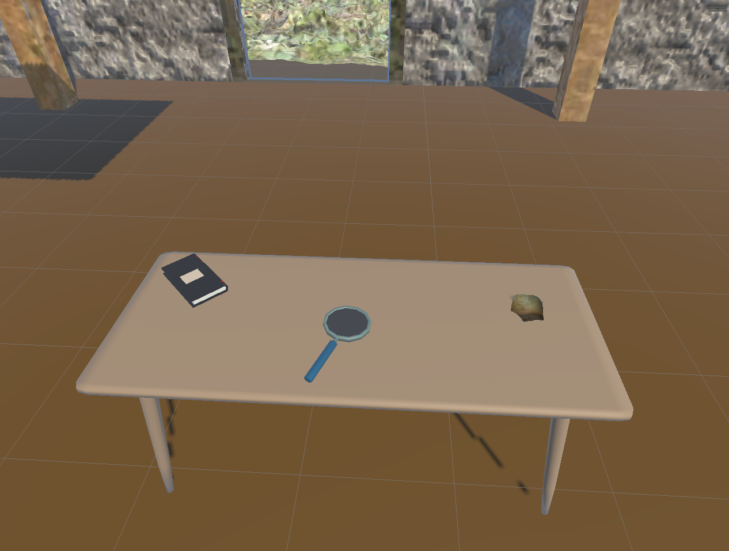
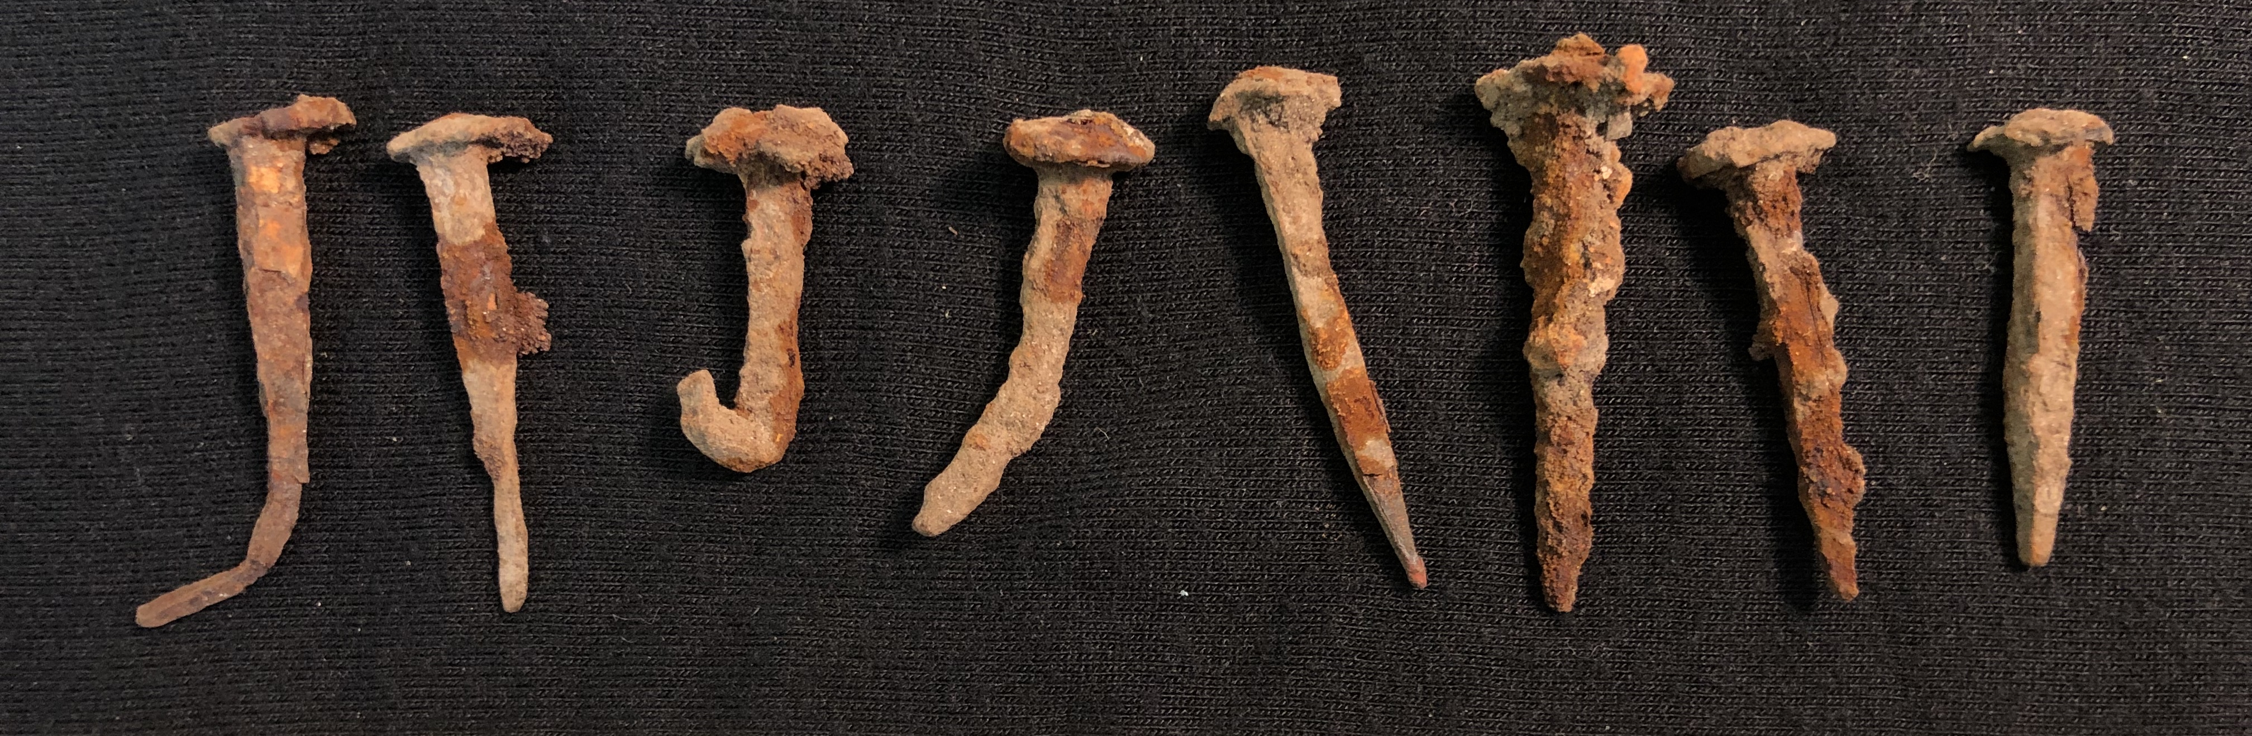
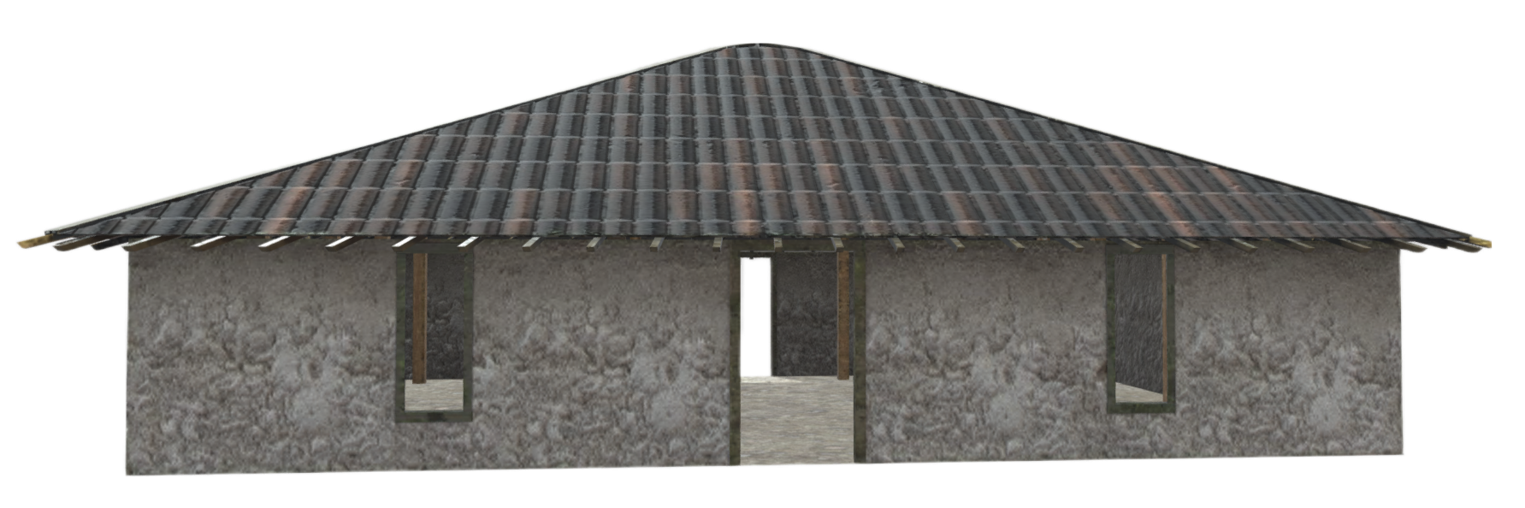
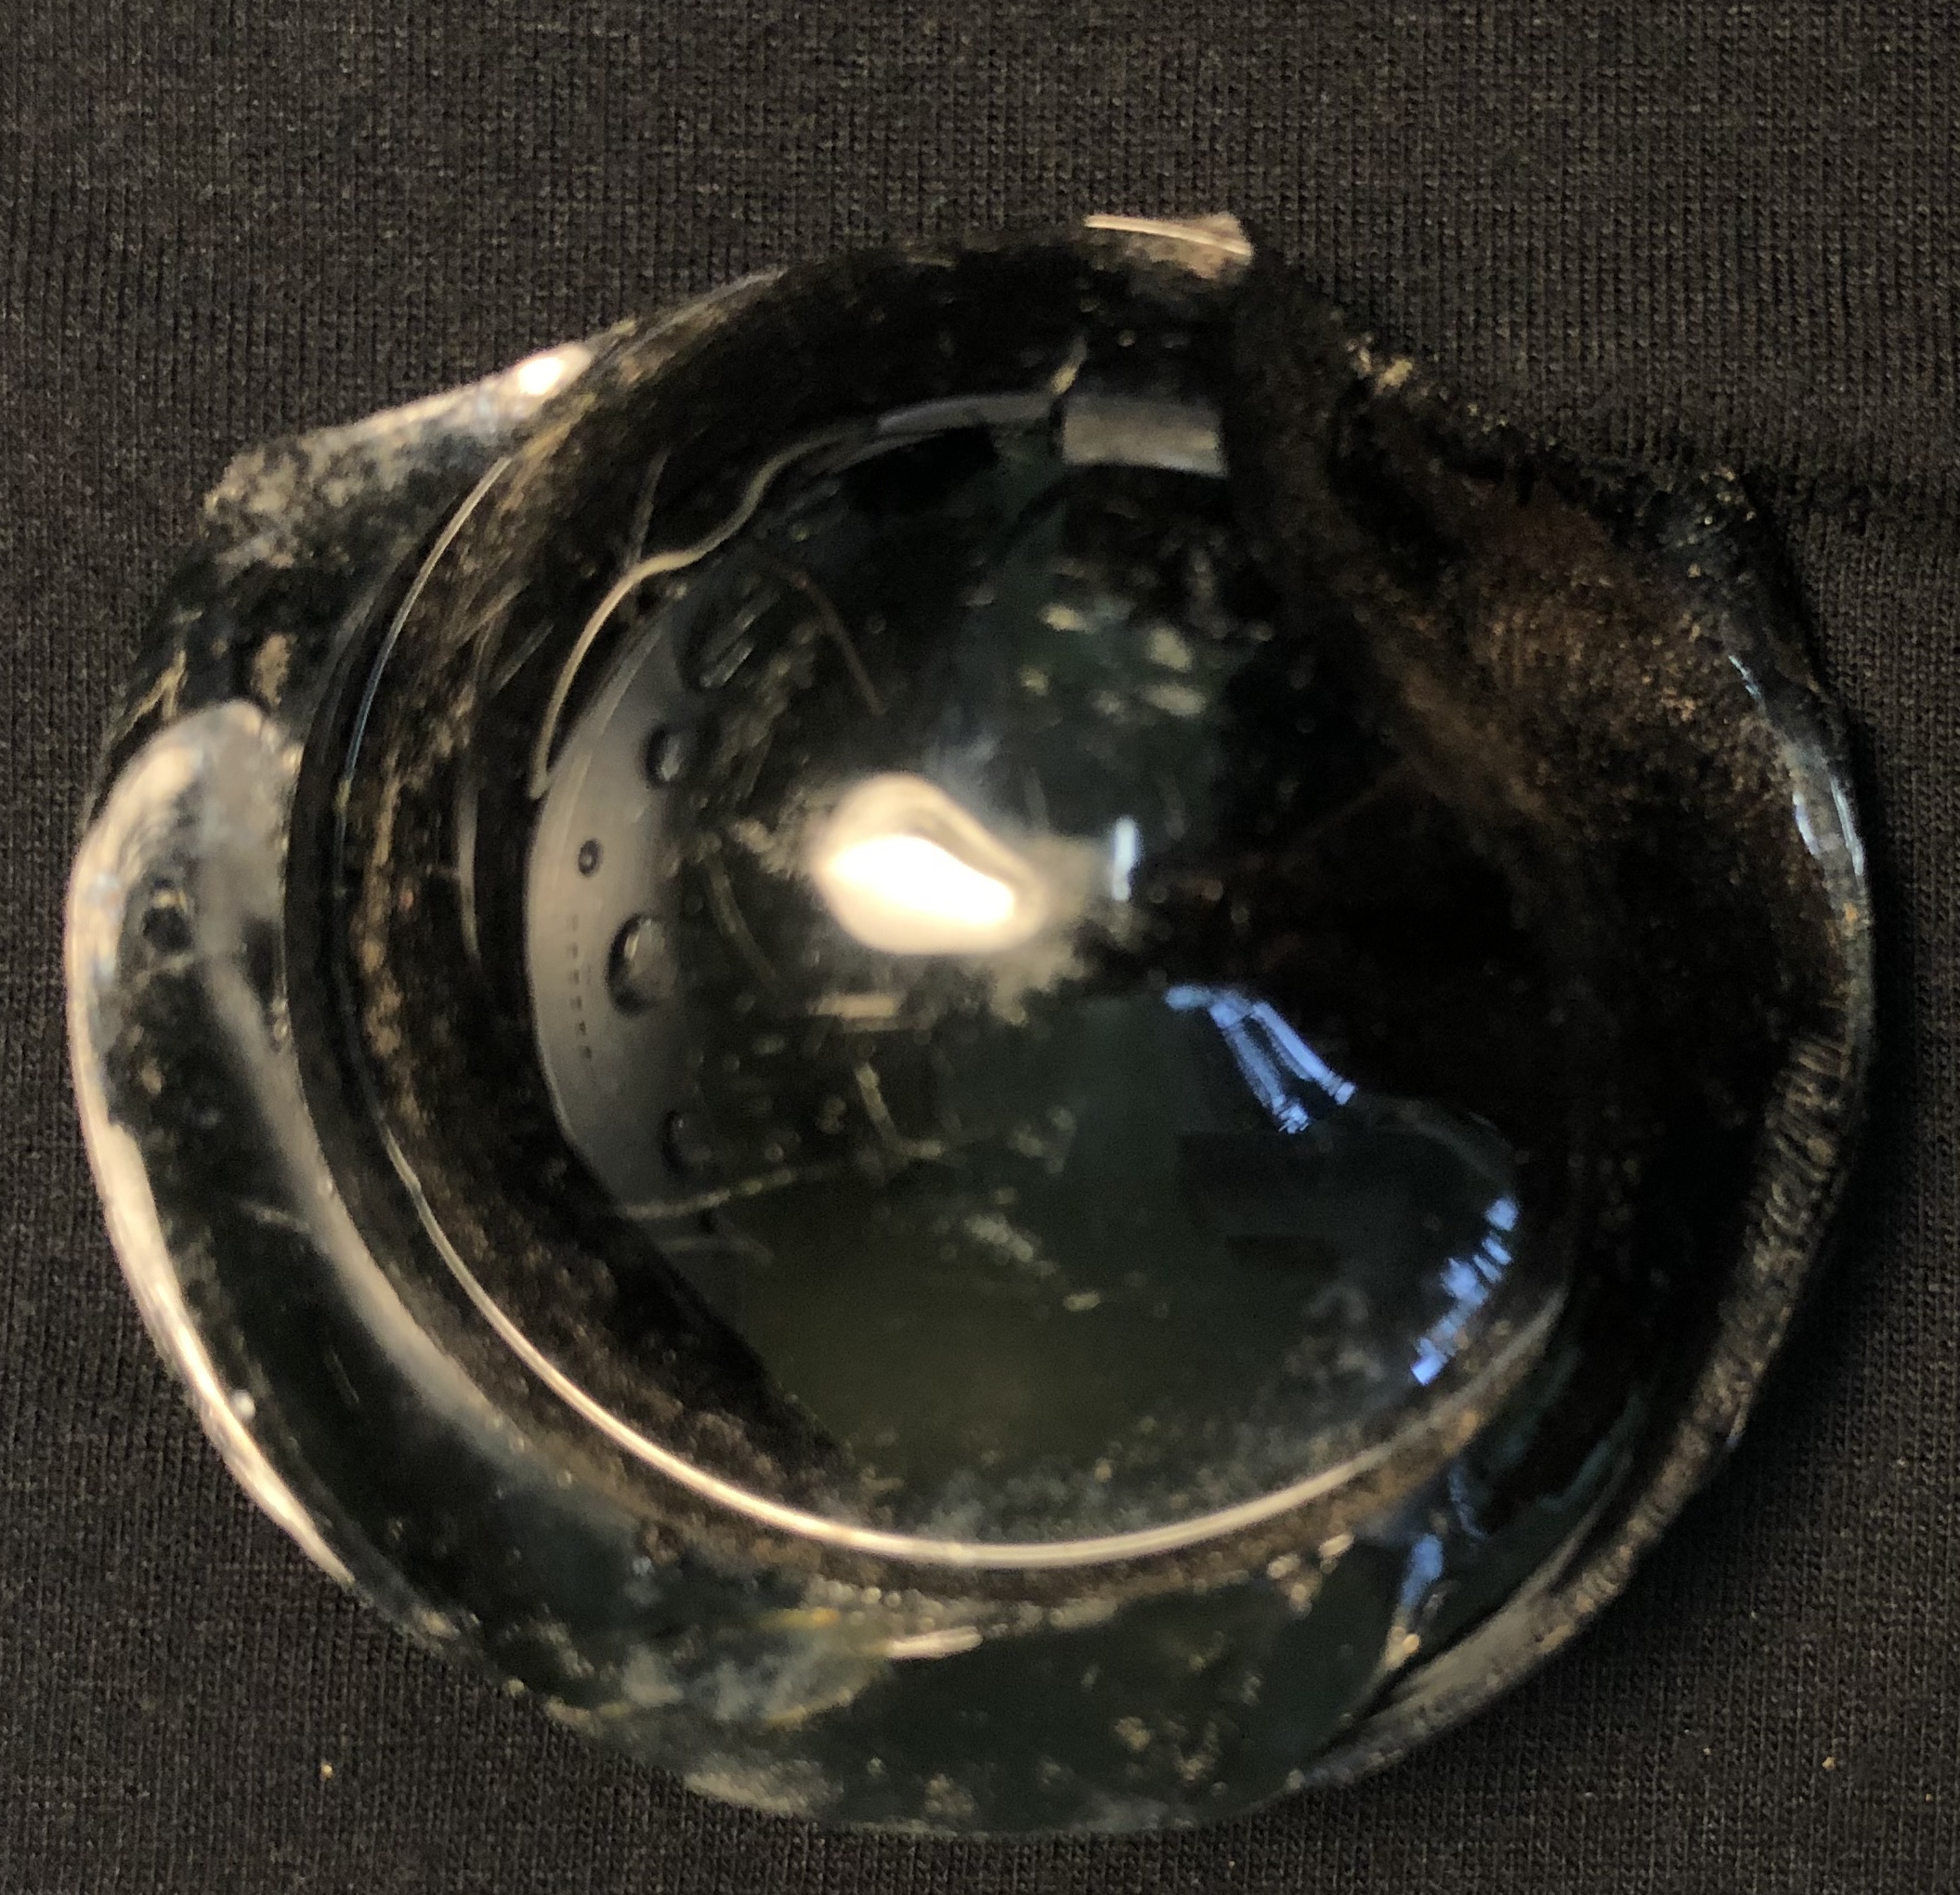
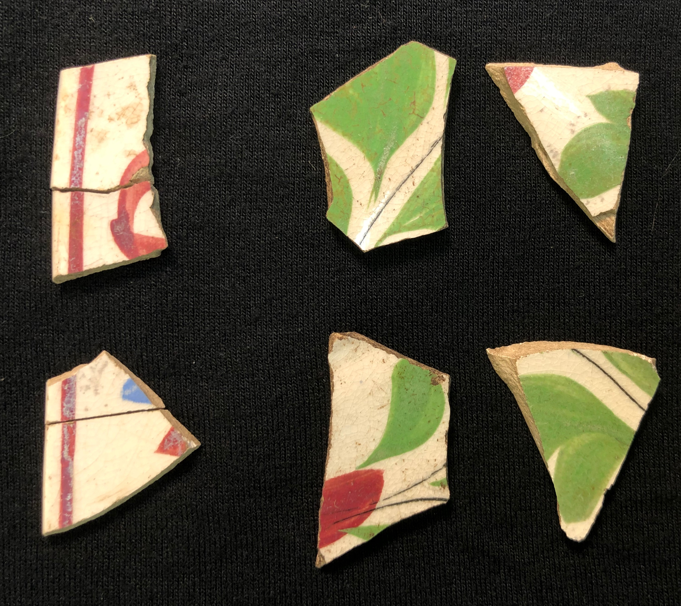



Barnwell Tabby House Exploration: Utilizing virtual reality to expand knowledge of an historic site to a broad audience
Cassy Cooper, Christoph Hagenauer, Tgaja Johnson, Zack Stillner, Marco Martinez, Nithish Nadham Dirisipamu
USCB Department of Computer Science & Mathematics (Faculty Mentor: Brian Canada, PhD)
HISTORY
The Barnwell Tabby House was most likley contructed in the 1820s or 1830s. Tabby is a structure made by burning oyster shells to create lime, then mixing it with water, sand, ash, and broken oyster shells.
GEOLOGY
Barnwell Tabby House Exploration allows for the safe exploration of the 200-year-old Barnwell tabby house on Hilton Head Island, South Carolina. Over time the tabby house has become dangerous not only for the public but also for the preservation of the house.
Add picture description here
ARCHAEOLOGY​
A section of the Tabby House flooring was removed while said section was covered by a tarp so that no light could reach the sand beneath the floor. This was done so that the testing would tell us the last time the sand had been exposed to light, allowing for approximate dating of construction for the Tabby House.
Barnwell Tabby House Exploration will allow a piece of history to be experienced by everyone. Users will employ their joysticks to walkthrough the tabby house via teleportation points and select objects that will provide historical descriptions provided from archeological research by others. The app will consist of three different views: the actual house, the restored house, and the site at its correct point in history. Barnwell Tabby House Exploration will provide an interactive learning experience for one of South Carolina’s oldest locations.
More information about the Barnwell Tabby House can be found here: https://www.islandpacket.com/news/local/article178140686.html

